Slide 1
CST2550 - 2025
Software Engineering and Management
Week 1: Module Intro & Introduction to Software Engineering and C# .NET
Ahmed Eissa
a.eissa@mdx.ac.uk

Slide 2
Module Topics
Required programming concepts in C# (or Java)
  Software engineering:
    software development life cycle
    testing
    tools/techniques
  Algorithms and data structures:
    timing algorithms
    analysing algorithms
    asymptotic notation
    data structures
    graphs and graph algorithms

Slide 3
Teaching Team
Ahmed Eissa (Hendon) [Module Leader]
Raheb Almouaamen (Hendon)
Runem Remo (Hendon)
Ahmed Bezan (Hendon)
Karel Veerabudren (Mauritius)
Aisha Idoo (Mauritius)
[Note: full contact details in module handbook]

Slide 4
About Your Lecturer
Background
Research
Other information:
  Office Hours: Every Thursday from 13:00 to 15:00.
  Office location: T116
  Email: a.eissa@mdx.ac.uk

Slide 5
Module Structure
12 weeks
Group Coursework and Online Test
Scheduled teaching (24%):
  Lectures & Labs
Independent study (76%):
  Reading
  Complete lab tasks
  Practice
  Coursework

Slide 6
Expected From You
Attend all timetabled sessions on time
Focus on lab sessions
Engage fully with all activities (lab, lecture, coursework)
Complete all lab tasks (may have to continue outside of lab)
Complete all independent study activities
Tell us ASAP if you are struggling
Regularly check university email and Moodle page
Complete all coursework and submit on time
Plan your time (especially coursework)

Slide 7
Support you will receive
Availability outside of lab sessions for support (office hours, or email for appointment)
Teaching materials available on Moodle
Discuss coursework drafts before submission
Coursework feedback within 15 working days of submission

Slide 8
Do not expect
Lecturers to do tasks for you (you won’t learn anything from this)
Coursework to be marked before submission
Coursework extensions (the university policy is to apply for extenuating circumstances)
Knowledge to be transmitted you (learning is achieved through your hard work and practice)

Slide 9
Assessment Weighting
1 Online tests [50%]
1 Group Coursework [50%]:
  Software design, project management and implementation of mini-project (milestones, presentation and report) [25%]
  Algorithms and data structures of mini-project (code, testing and demonstration) [25%]

Slide 10
The Online Test
A short test
Specific topics
Online (Moodle)
Random questions
Question types includes:
  multiple choice
  short answer
  matching
Time limit

Slide 11
The Coursework
Group coursework
Due week after Easter
Finish uploading before the deadline: submit early
Report/presentation/management/testing and source code
Apply material learnt in previous weeks
Full details released in coursework specifications
Although it is a group coursework, but you will get individual mark
Only the group leader can submit on behalf of the group team

Slide 12
Plagiarism and Collusion
Submitting others work as your own
Submitting your own work again for another assessment
Not acceptable and will not be tolerated
Penalties include failing coursework task, failing module

Slide 13
Examples of Plagiarism and Collusion
Working together on individual work (even with minor changes)
Getting others (e.g., friends, SLAs, GAAs) to do your work for you
Including text/code found online (even with changes) without referencing
Using A.I. aided technologies (like ChatGPT)

Slide 14
Extenuating Circumstances
Unable to submit coursework with valid reason
Apply through UniHelp as early as possible
Supply any required evidence
If accepted, you will be given a deferral/extension on that work
This is not decided by academic staff
Let me know ASAP if you have been granted a deferral or extension

Slide 15
Class Rules
Attendance and punctuality are essential
Be prepared (review lecture, read textbook)
Focus on the tasks during lab times
There will be scheduled breaks to relax
Engage fully with all activities
Non-engagement or disruptive behaviour may be asked to leave

Slide 16
Better Attendance Leads to
Better Grades
Figure 1: Grades as a function of attendance on this module.

Slide 17
Further Reading
Module Handbook (on Moodle)

Slide 18
Week 1: Introduction to Software
Engineering and C# .NET
Learning Objectives
  Understand core software engineering principles.
  Learn C# fundamentals and .NET framework basics.
  Set up the development environment (Visual Studio).

Slide 19
Software Engineering Overview
What is Software Engineering?
Software engineering is the systematic application of engineering approaches to software development. It involves:
  Systematic methodology: Employing structured and well-defined processes to ensure consistency and reliability in software development.
  Disciplined, quantifiable approach: Using metrics, analysis, and evaluation to measure and improve software quality.
  Development, operation, and maintenance: Addressing the entire software lifecycle, from initial design to deployment and updates, ensuring sustainability and adaptability.

Slide 20
Software Engineering Overview
Why is Software Engineering Important?
Helps build reliable, maintainable, and scalable systems.
Reduces costs by minimising errors and improving efficiency.
Addresses challenges like complexity, evolving requirements, and team collaboration.

Slide 21
Key Principles of Software Engineering
Abstraction
  Definition: The process of hiding unnecessary details and exposing only the essential features of a system.
  Purpose: Simplifies system complexity, making it easier to manage and understand.
  Example: A car dashboard abstracts the complexities of the engine, displaying only necessary information like speed and fuel level.

Slide 22
Key Principles of Software Engineering
Modularity
  Definition: Dividing a system into smaller, self-contained modules or components.
  Benefits:
    Enhances maintainability by isolating changes to specific modules.
    Facilitates parallel development by allowing teams to work on different modules independently.
    Promotes code reuse across projects.
  Example: A web application divided into modules for authentication, database access, and user interface.

Slide 23
Key Principles of Software Engineering
Encapsulation
  Definition: Restricting access to certain parts of an object and exposing only the necessary interfaces.
  Purpose:
    Protects data integrity by preventing unauthorized access or modification.
    Enables loose coupling between components, making systems more adaptable.
  Example: A class in C# with private variables and public methods to access them.

Slide 24
Introduction to C# and .NET

Slide 25
C# Language Features
Object-Oriented Programming (OOP)
  Definition: A programming paradigm based on the concept of "objects" that represent real-world entities.
  Core Concepts:
    Classes and Objects: A class is a blueprint, and an object is an instance of that class. For example, a Car class with properties like colour and speed can create objects like myCar.
    Inheritance and Polymorphism: Mechanisms to create hierarchies and enable dynamic behaviour, such as overriding methods.
    Encapsulation and Abstraction: Simplifying complexity and protecting system integrity, as covered earlier.

Slide 26
C# Language Features
Type Safety
  Definition: Ensuring that variables and operations adhere strictly to their defined types.
  Advantages:
    Reduces runtime errors by catching issues during compilation.
    Improves code readability and maintainability.
  Features:
    Strong Type Checking: Prevents assigning incompatible types (e.g., assigning a string to an integer).
    Type Inference: Allows the compiler to deduce the type of a variable, making code more concise (e.g., var name = "John").
    Generic Types: Enables type-agnostic definitions for collections and methods, such as List<T> for lists of any type.

Slide 27
C# Language Features
Memory Management
  Definition: The process of allocating and deallocating memory resources during program execution.
  Features:
    Garbage Collection: Automatically reclaims unused objects, reducing memory leaks and manual effort.
    Resource Management: Ensures efficient use of system resources, such as file handles and network connections.
    Disposal Patterns: Implements interfaces like IDisposable for deterministic cleanup of unmanaged resources (e.g., database connections).

Slide 28
.NET Framework Architecture
Common Language Runtime (CLR)
  Definition: The execution engine for .NET applications, providing services like memory management, exception handling, and security.
  Key Features:
    Just-In-Time (JIT) Compilation: Converts intermediate code (IL) into machine code at runtime for optimal performance.
    Garbage Collection: Automatically manages memory allocation and cleanup.

Slide 29
.NET Framework Architecture
Base Class Library (BCL)
  Definition: A collection of reusable classes and methods for common programming tasks.
  Capabilities:
    File I/O operations.
    Data manipulation (e.g., sorting, searching).
    String handling and regular expressions.

Slide 30
.NET Framework Architecture
Language Independence
  Definition: Supports multiple programming languages within the .NET ecosystem.
  Benefits:
    Enables interoperability between components written in different languages (e.g., combining C# and F#).
    Promotes code sharing and collaboration across teams.

Slide 31
Setting Up the Development Environment

Slide 32
Setting Up the Development Environment
1. Installing Visual Studio
  Steps:
    Visit the official Visual Studio website.
    Download the Community Edition (free) or a licensed version (If you can afford one).
    Follow the installation wizard to select required workloads (e.g., .NET desktop development).
  Features of Visual Studio:
    IntelliSense: Real-time code suggestions and error detection.
    Debugging tools: Breakpoints, watches, and call stack analysis.
    Extensions: Add-ons for productivity, such as code analysers and version control integrations.

Slide 33
Setting Up the Development Environment
2. Creating Your First C# Project
  Walkthrough:
    Open Visual Studio and select "Create a new project."
    Choose "Console App (.NET Core)" and configure project settings.
Write a simple "Hello World" program (next slide)
Run the program and observe the output in the console.

Slide 34
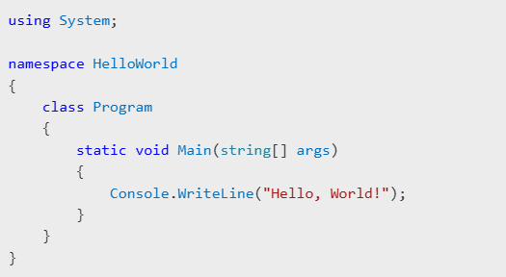
Setting Up the Development Environment

Slide 35
Exploring the IDE
  Components:
    Solution Explorer: Manages files and dependencies.
    Properties Window: Displays attributes of selected items.
    Output Window: Shows build and runtime logs.
  Tips for Productivity:
    Use keyboard shortcuts for common tasks.
    Customise themes and layouts for comfort.

Slide 36
Summary and Q&A
Recap of key software engineering principles and their importance in managing complexity and enhancing software quality.
Overview of C# features, emphasizing its role as a robust and type-safe language for modern applications.
Introduction to the .NET framework, highlighting its comprehensive tools and runtime services.
Setting up a practical development environment to start coding efficiently.

Slide 37
Questions or Discussions?
How do abstraction and encapsulation differ in practice?
What challenges might arise in setting up a new development environment?
Any additional concepts to explore in Visual Studio or .NET?

Slide 38
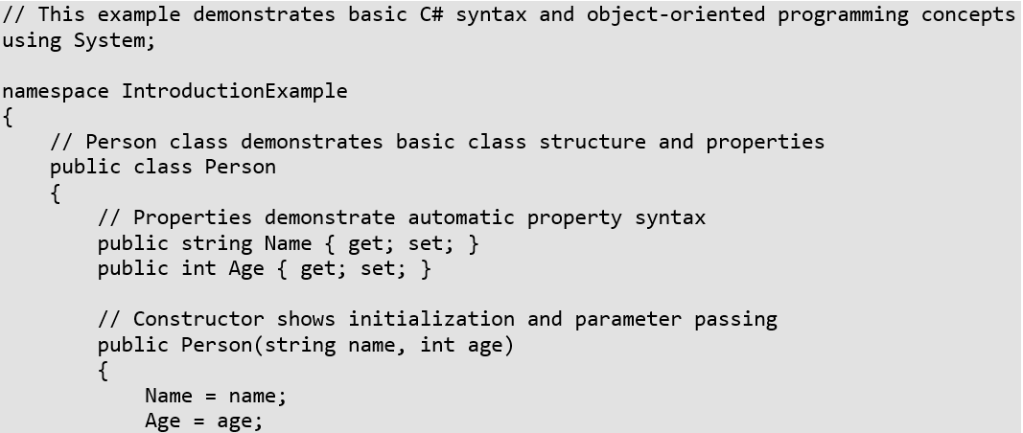
Practical Examples
Example 1: Basic C# Program Structure
Notes:
Improvise an example

Slide 39
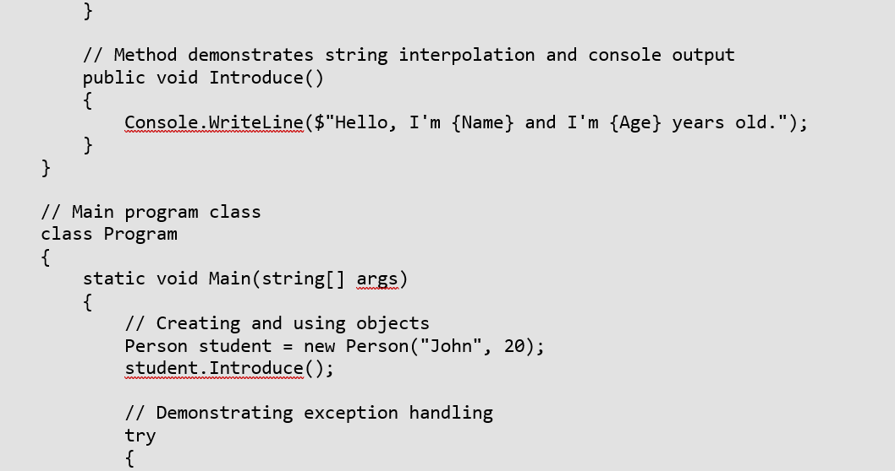
Practical Examples

Slide 40
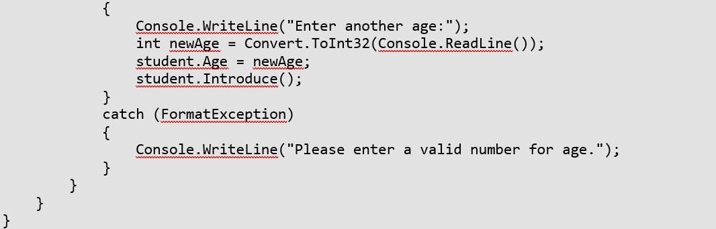
Practical Examples

Slide 41
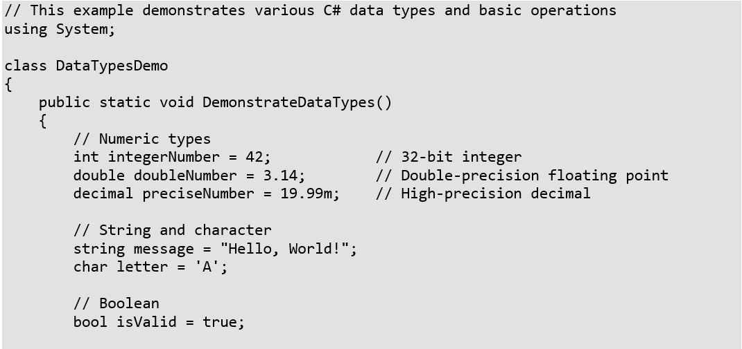
Practical Examples
Example 2: Basic Data Types and Operations

Slide 42
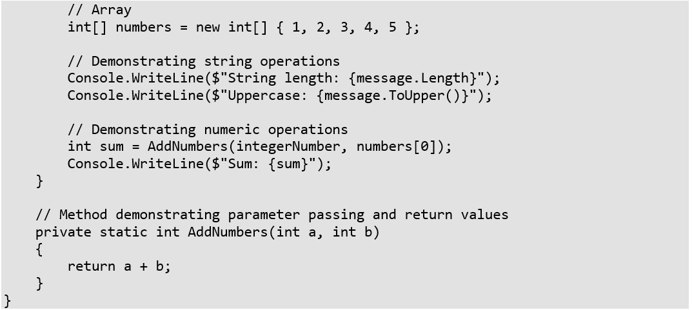
Practical Examples

Slide 43
Practice Exercises
Basic Class Creation
  Create a Student class with properties for ID, Name, and Grade
  Add methods to calculate grade average
  Implement proper validation
Console Application
  Create a simple grade calculator
  Practice user input and output
  Implement error handling

Slide 44
Additional Resources
Microsoft C# Documentation
Visual Studio Community Edition download link
.NET Framework documentation

Slide 45
Next Week
Data Structures - Arrays and Lists

